Slide 1
Java 2 : Reflection

Slide 2
Agenda
Introduction
Reflection Tutorial
Drawbacks
Additional Resources

Slide 3
Reflection
“Allowing a program to look at itself.”
Allows you to dynamically change elements during runtime
Why?
Allows you to “explore” a library without having documentation
Allows frameworks to work with multiple class designs
Spring, JavaFX, jUnit
Think object, shape creation
Sometimes helpful when debugging

Slide 4
Reflection
Why (continued)?
Allows you to discover useful information about a class:
Variables/Methods
Interfaces
Constructors
Package Information
Parent Classes

Slide 5
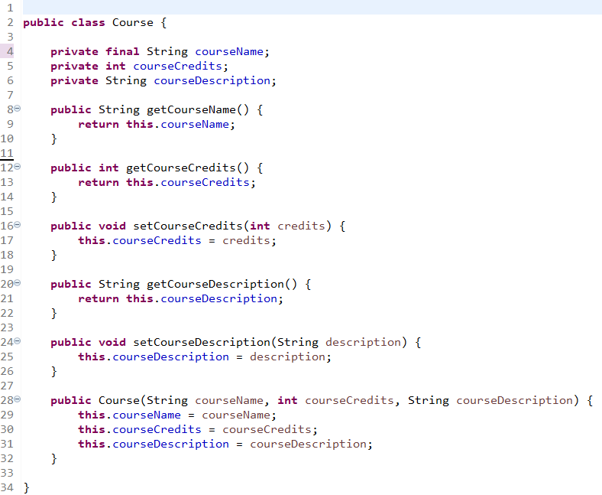
Setup
Setup an example class:

Slide 6
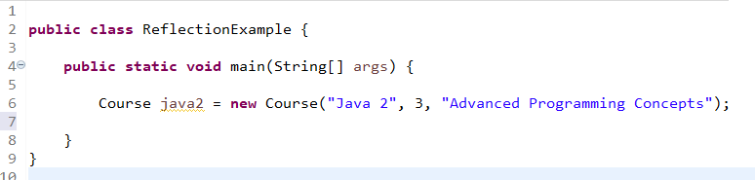
Setup
Build a Test Method

Slide 7
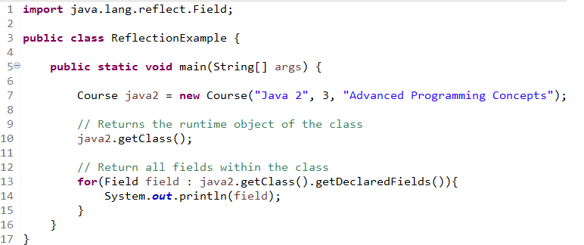
Reflection Tutorial
java2.getClass() returns the runtime object of the class, allowing any other class within scope to dynamically access properties of the class
java2.getClass().getDeclaredFields(); returns all fields defined in the class:
Notes:
private final java.lang.String Course.courseName
private int Course.courseCredits
private java.lang.String Course.courseDescription

Slide 8
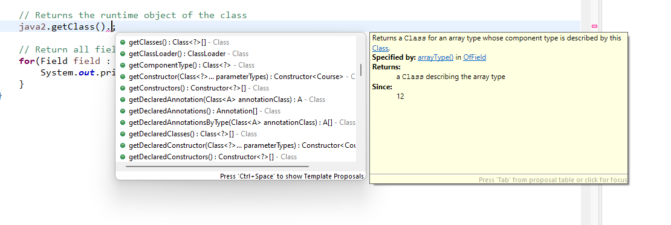
Reflection Tutorial
Need to import java.lang.reflect.*
Using IntelliSense, examine all the other properties you can retrieve:

Slide 9
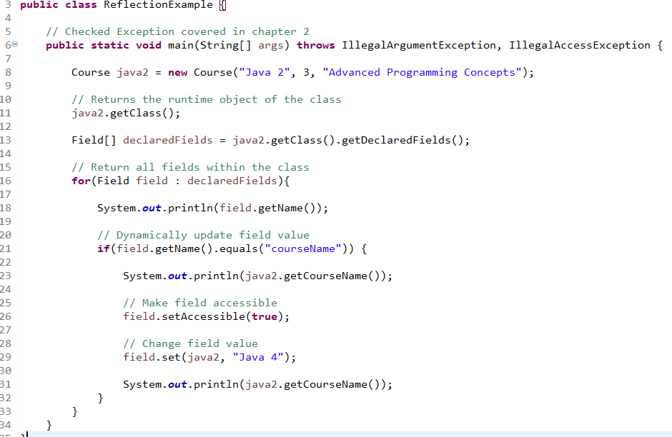
Reflection Tutorial
Reflection allows you to modify final properties!

Slide 10
Reflection Tutorial
setAccessible() method is needed to tell Java runtime to ignore the otherwise “illegal” action
setField() calls a Checked Exception
Covered in Chapter 2
Order of Fields/Methods will be dynamic based on runtime compilation

Slide 11
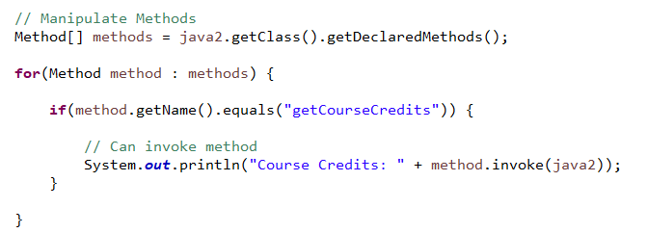
Reflection Tutorial
Can perform the same operations with methods

Slide 12
Reflection Tutorial
Method.setAccessible(true) will let you invoke private and/or static methods!

Slide 13
Drawbacks
Extremely easy to create new bugs in a running system
May break other classes/constructs relying on specific variable/method naming
Reflection library is slow, very little ability for compilation optimization

Slide 14
Additional Resources
Oracle Documentation
Baeldung Documentation

Slide 15
Key Takeaways
What you need to know
Be able to identify the output of code using instanceof
Recognize correct and incorrect implementations of equals(), and .toString()
Be able to create enum classes
Identify and use nested classes
Understand the rules for method overriding and overloading

